Slide 1
TEACHER CUE
CFU
HINT
Scaffolding for students
MAKE THE CONNECTION
Allow students to make the connection

Slide 2
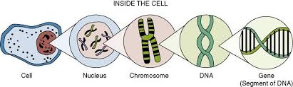
What does DNA stand for?
What shape is DNA?
What is a gene?
What binds with Adenine?
What binds with Cytosine?
Can you draw a DNA molecule
Notes:
A gene is a small section of DNA? that contains the instructions for a specific molecule, usually a protein

Slide 3
Can you please write in your book what you now know from last week regarding DNA
➔Please put in dot points
➔If you are unsure how to spell a word please put your hand up and ask me to check

Slide 4
I can describe how mitosis relates to DNA
TRACK WITH ME
READ WITH ME
^{I can define mitosis}
I can list the phases of mitosis
I can explain the phases of mitosis

Slide 5
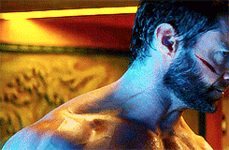
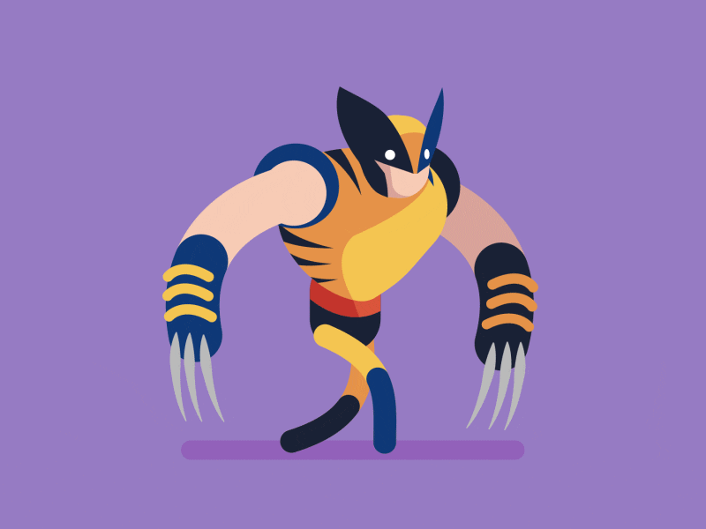
I can describe how mitosis relates to DNA
Which superpower is Wolverine (X-Men) showing?
How do you think this relates to Mitosis?

Slide 6

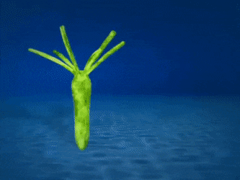
I can describe how mitosis relates to DNA
Mitosis
Occurs during the growth and repair of cells and in asexual reproduction (reproduction without gametes and fertilisation)
Examples of asexual reproduction
Sea stars
Budding
Cloning

Slide 7
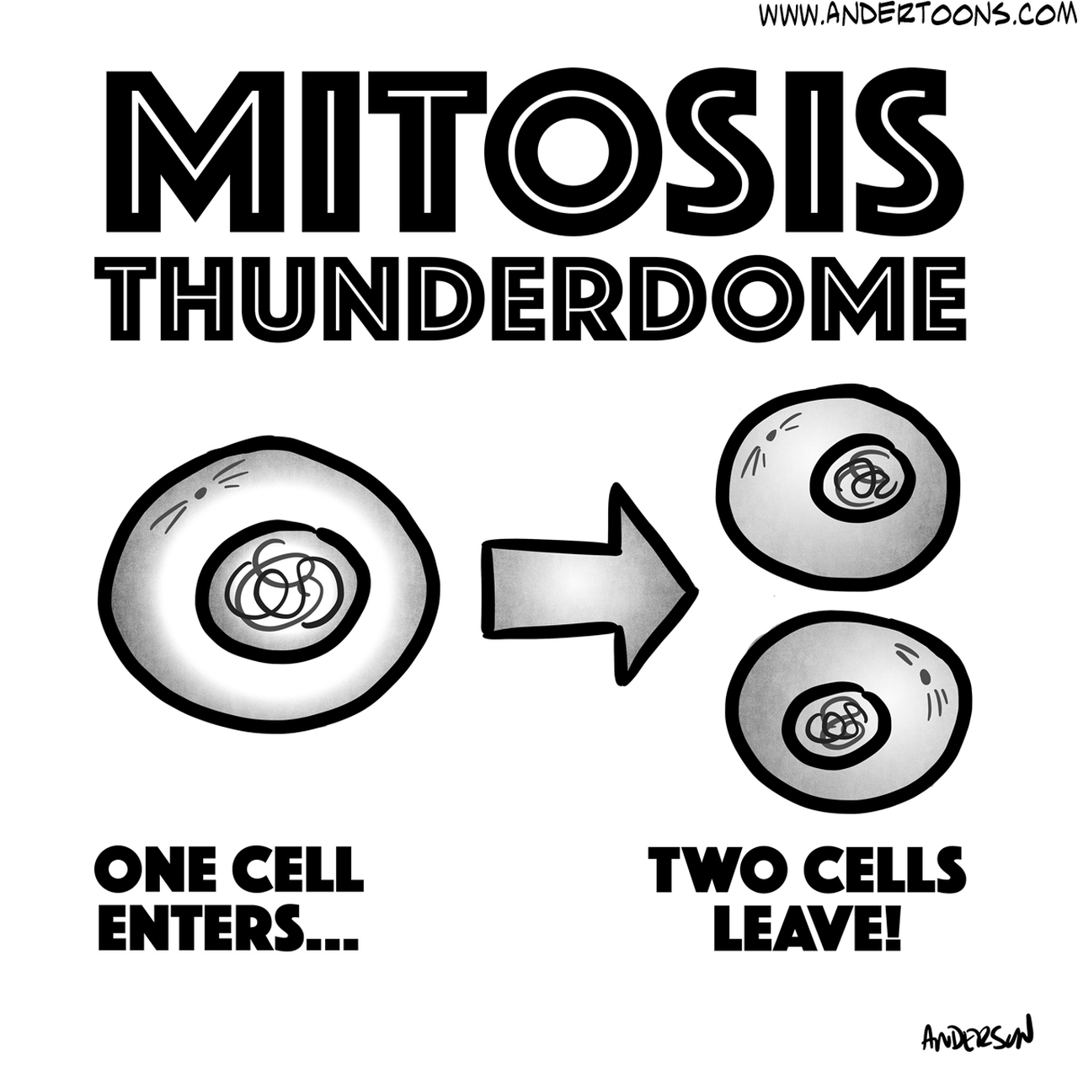
I can describe how mitosis relates to DNA
Mitosis
The cells produced by mitosis are genetically identical to each other and to the original cell.
They have the same number of chromosomes and DNA instructions.
Hence they can be described as clones of each other!

Slide 8
I can describe how mitosis relates to DNA
TEACHER CUE
CFU
During Mitosis you create DNA
What happens:
Chromosomes split in half to make two new chromosomes

Slide 9
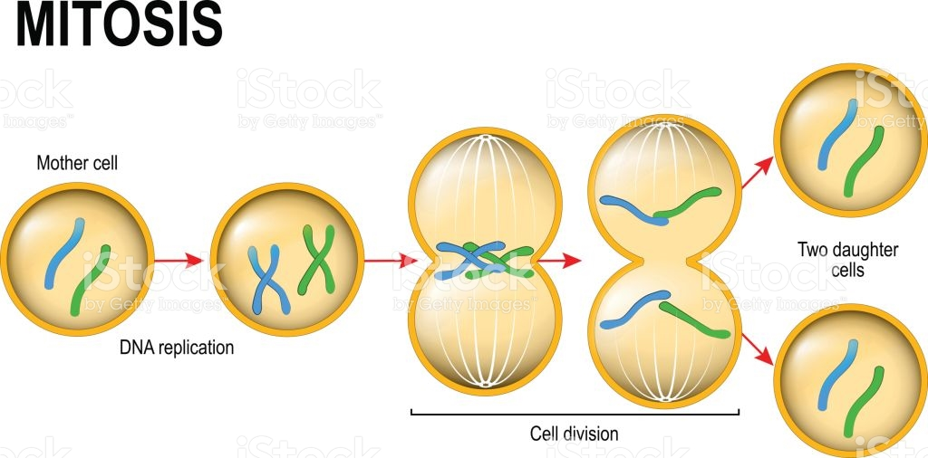
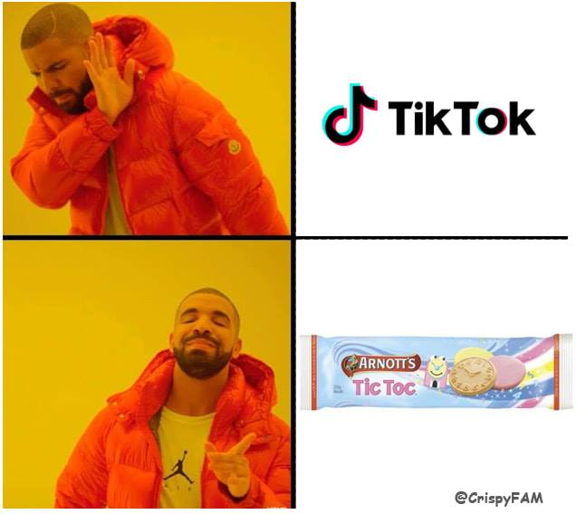
I
Played
Minecraft
And
Tik tok
I can describe how mitosis relates to DNA

Slide 10
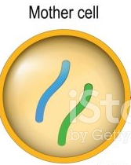
I
Played
Minecraft
And
Tik tok
I can describe how mitosis relates to DNA
Stage 1: Interphase
Cells spend 90% of their time in ‘Interphase’
The DNA in the cell is copied in preparation for cell division
This results in two identical full sets of chromosomes
Remember:
Humans have 23 pairs of chromosomes (46 in total)

Slide 11
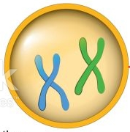
I
Played
Minecraft
And
Tik tok
I can describe how mitosis relates to DNA
Stage 2: Prophase (Plump)
The chromosomes condense into X-shaped structures that can be seen easily under a microscope
Both copies of chromosome 1 are together, both copies of chromosome 2 are together, etc…
At the end of prophase the membrane around the nucleus in the cell dissolves – releasing the chromosomes!
Centromere
Chromosomes

Slide 12
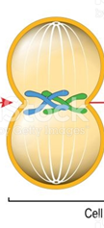
I
Played
Minecraft
And
Tik tok
I can describe how mitosis relates to DNA
Stage 3: Metaphase (Middle)
The chromosomes line up neatly end-to-end along the centre (equator) of the cell
M for middle!
Chromosomes line up in the middle

Slide 13
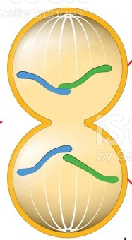
I
Played
Minecraft
And
Tik tok
I can describe how mitosis relates to DNA
Stage 4: Anaphase (Away)
The sister chromatids are then pulled apart to opposite poles (e.g. North and South)

Slide 14
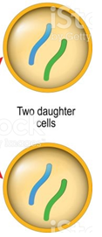
I
Played
Minecraft
And
Tik tok
I can describe how mitosis relates to DNA
Stage 5: Telophase (Two)
At each pole of the cell a full set of chromosomes gather together.
A membrane forms around each set of chromosomes to create two new nuclei
The single cell then pinches in the middle to form two separate daughter cells, each containing a full set of chromosomes within a nucleus (cytokinesis)
Two new cells are formed

Slide 15
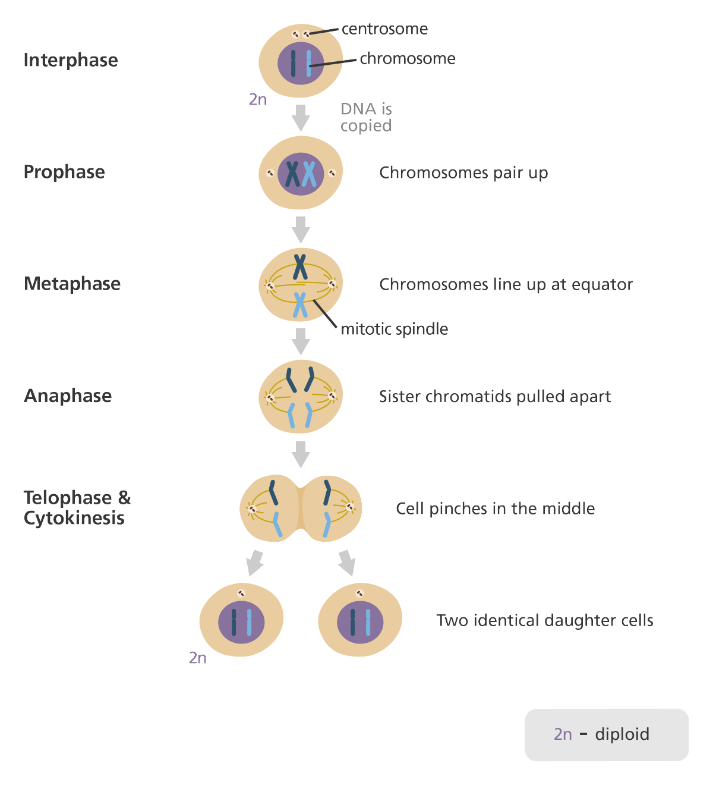
I can describe how mitosis relates to DNA

Slide 16
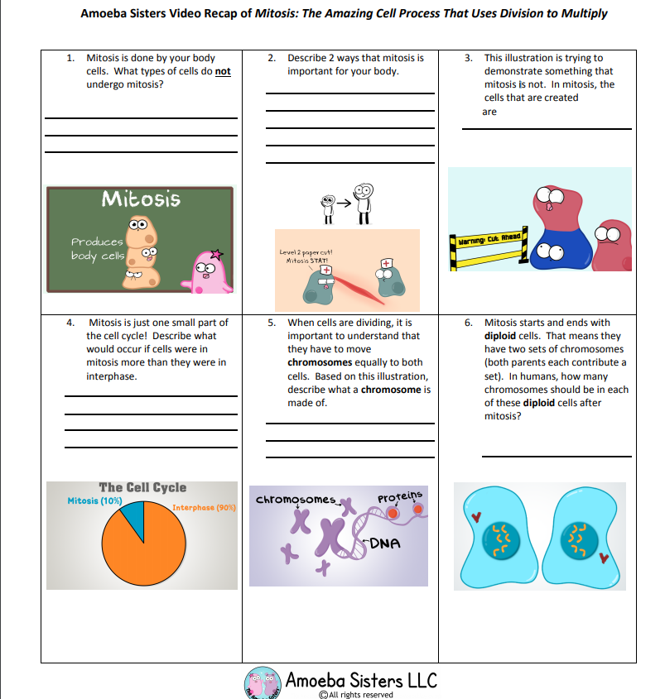
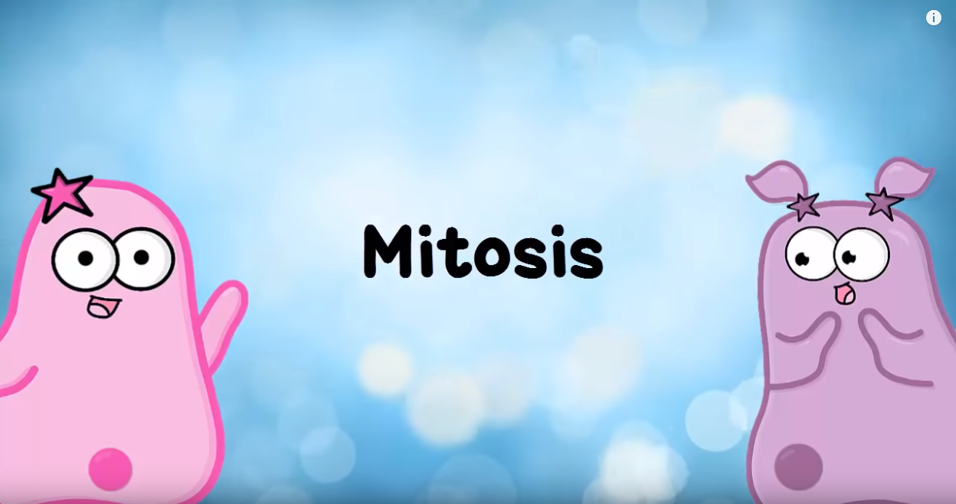
I can describe how mitosis relates to DNA
https://www.youtube.com/watch?v=f-ldPgEfAHI

Slide 17
I describe how mitosis relates to DNA
TRACK WITH ME
READ WITH ME
^{I can link chromosomes and DNA}
I can give the names of phases of mitosis

